Slide 1
Presentation
North Western University
Name: Sajib Bhattacharjee
Id:20201070010
Presentation Name : BlaCk body and black hole.
Department: CSE
Section- B

Slide 2
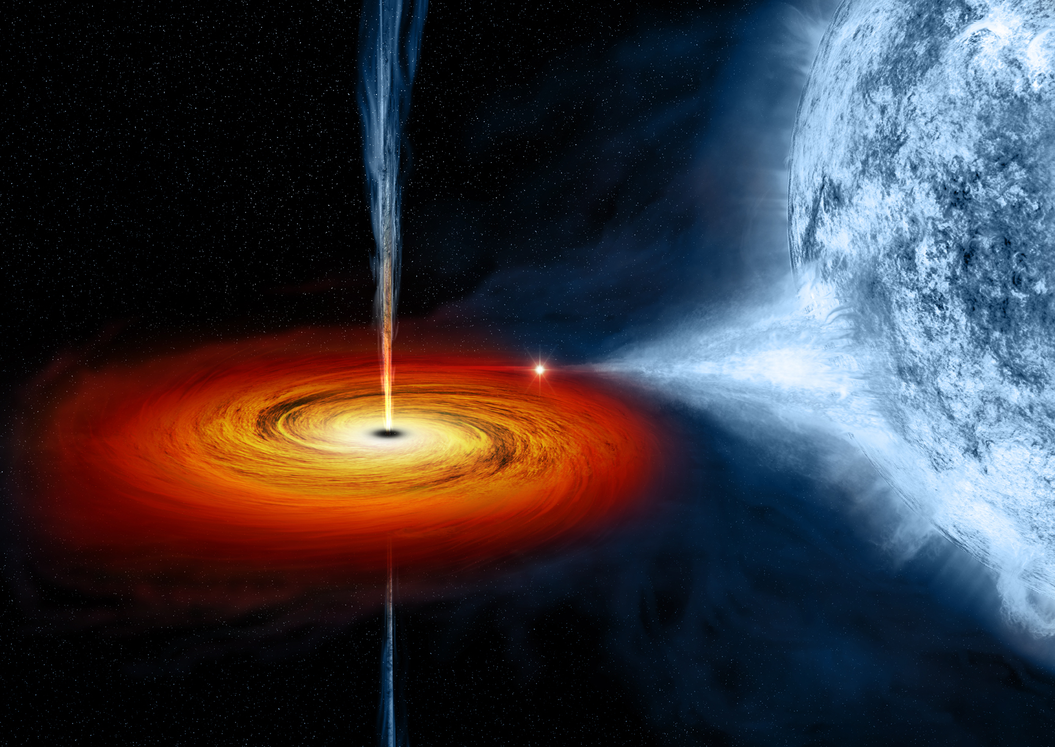
Black Hole.
A black hole is a place in space where
gravity pulls so much that even light
can not get out. The gravity is so strong
because matter has been squeezed into
a tiny space. This can happen when a star
is dying.
Because no light can get out, people can’t
see black holes. They are invisible. Space telescopes with special tools can help find black holes. The special tools can see how stars that are very close to black holes act differently than other stars.

Slide 3
How Big Are Black Holes?
Black holes can be big or small. Scientists think the smallest black holes are as small as just one atom. These black holes are very tiny but have the mass of a large mountain. Mass is the amount of matter, or "stuff," in an object . Another kind of black hole is called "stellar." Its mass can be up to 20 times more than the mass of the sun. There may be many, many stellar mass black holes in Earth's galaxy. Earth's galaxy is called the Milky Way . The largest black holes are called "supermassive." These black holes have masses that are more than 1 million suns together. Scientists have found proof that every large galaxy contains a supermassive black hole at its center. The supermassive black hole at the center of the Milky Way galaxy is called Sagittarius A. It has a mass equal to about 4 million suns and would fit inside a very large ball that could hold a few million Earths.
Formation Of Black Hole.
Scientists think the smallest black holes formed when the universe began.
Stellar black holes are made when the center of a very big star falls in upon itself, or collapses. When this happens, it causes a supernova. A supernova is an exploding star that blasts part of the star into space.
Scientists think supermassive black holes were made at the same time as the galaxy they are in.

Slide 4
Black Body
A black body is an idealized body that fully absorbs impinging electromagnetic radiation of any wavelength. Neither reflection nor transmission occur on it. A black body radiates at every wavelength the maximum possible energy for all possible emitters. The radiation density is independent of angles here. The black body forms the basis for understanding the physical principles of no contact temperature measurement technology and for calibrating infrared measuring devices.
Structure of the black body
The construction of a black body is in principle very simple. A heatable hollow body has a small hole at one end. If this body is brought to a certain temperature, this cavity is in temperature equilibrium. The ideal black radiation of the set temperature now emerges from the hole. Depending on the temperature range and intended use, the structure of such black bodies depends both on the material and on the geometric structure. For example, if the hole in the wall is very small compared to the entire surface, the disturbance of the ideal state may be considered as low. If one only looks at this hole with a sensor, the exiting temperature radiation can be regarded as a black body and the measuring device can be calibrated with it.

Slide 5
Radiation laws of the black body
→ Planck's Law of Radiation describes the spectral specific radiation Mλs of the black body into the half-space as a function of its temperature T and the observed wavelength λ. It thus represents the most basic relationship for non-contact temperature measurement.
The maximum of the spectral specific radiation shifts with increasing temperature to shorter wavelengths. A variety of other relationships can be derived, two of which are briefly named below. By integrating the spectral radiation intensity over all wavelengths from zero to infinity, one obtains the value for the total radiation emitted by the body. This relationship is referred to as the → Stefan Boltzmann Law. MλS = σ · T4 [W · m-2] mit σ = 5,67 · 10-8 [Wm-2T-4] The total emitted radiation of a black body in the entire wavelength range increases in proportion to the fourth power of its absolute temperature. It can be seen from the graphical representation of Planck's Law of Radiation that the wavelength at which the emitted radiation of a black body emits the maximum shifts as the temperature changes. → Wien’s Displacement Law describes this connection and can be derived by differentiation from Planck's equation. The wavelength at which the maximum of the radiation is located shifts with increasing temperature to the short-wave range.

